Slide 1
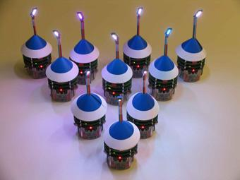
Wireless collaboration of autonomous vehicles
Methods of communication:
Satellite
Cellular
2.4 Ghz Wireless
Radio
Optical
What is the most reliable, flexible, and cost effective method?

